Slide 1
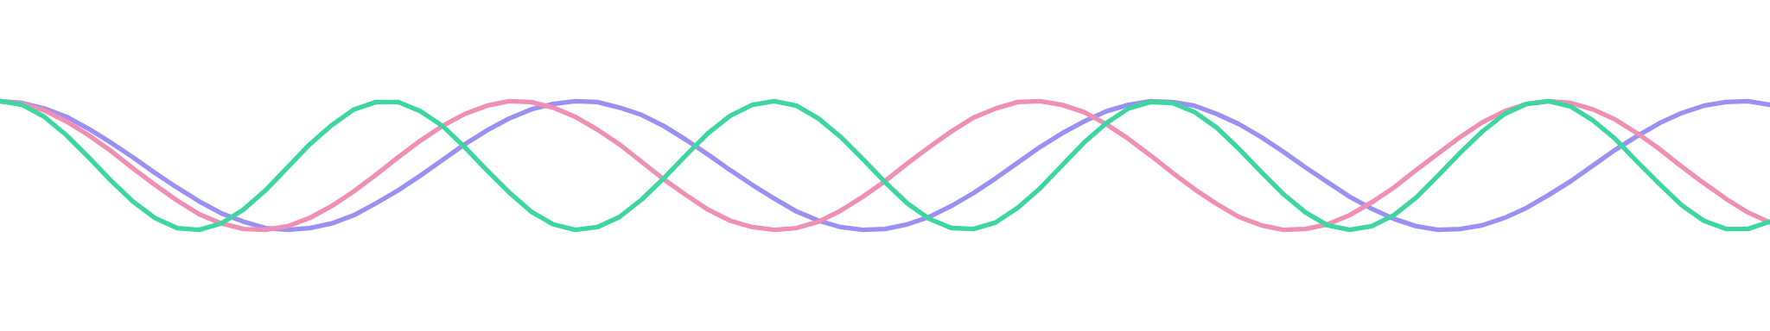
Neutrino Oscillations
How a particle can change its identity while it travels
Aarush Lunawat - 26MS IISER Kolkata
Notes:
Welcome. Today: what a neutrino is, the puzzle that led to the discovery of oscillation, why flavor changes, and how it connects to quantum computing. The three waves at the bottom are the central picture of the talk: three mass states that start in step and drift apart as they travel.

Slide 2
What is a neutrino?
THE PARTICLE
EVERY SECOND, THROUGH YOU
A lepton
Spin one half
A fundamental particle in the same family as the electron, the muon and the tau.
A fermion, like the electron and the proton.
60 billion
No charge
Tiny mass
solar neutrinos cross every square centimeter of your body. Nearly all of them pass straight through.
It feels only the weak force and gravity, so matter barely interferes with it.
At least a million times lighter than the electron, but not zero.
2
Notes:
A neutrino is one of the most abundant particles in the universe, but it interacts so weakly that it is very hard to catch. It is a lepton, has no electric charge, and has an extremely small but non-zero mass. That last point is the key to this whole talk.

Slide 3
Each neutrino has a charged partner
THREE FLAVORS
ν_{e}
ν_{μ}
ν_{τ}
Electron neutrino
Muon neutrino
Tau neutrino
Partner: Electron
Partner: Muon
Partner: Tau
Made in the Sun and in nuclear reactors.
Made in the atmosphere and in accelerator beams.
The hardest to detect, first seen in the year 2000.
Flavor is the label we read off when a neutrino is made or detected: which charged lepton it is paired with in a weak interaction.
3
Notes:
The word flavor only tells us how the neutrino was made or how it is detected. A muon neutrino that hits a nucleus can produce a muon, but not an electron. Keep this definition in mind, because later we will see that flavor is not the same thing as mass.

Slide 4
A puzzle that took decades to solve
THE DISCOVERY
1930
1956
1968
1998
2001
2015
Pauli proposes a neutral, very light particle to save energy conservation.
Cowan and Reines detect neutrinos from a nuclear reactor.
Homestake sees only about a third of the expected solar neutrinos.
Super-K finds atmospheric muon neutrinos disappearing.
SNO shows the missing solar neutrinos arrive as other flavors.
Nobel Prize in Physics for Kajita and McDonald.
Detectors were counting far fewer neutrinos than theory predicted. Where was the rest?
4
Notes:
Walk along the timeline. The orange cards are the puzzle: the Sun and the atmosphere produced fewer neutrinos of the expected kind than anyone could count. The blue card is the resolution, when SNO showed that the total number was right and only the flavors had changed. Kajita and McDonald received the 2015 Nobel Prize for the discovery of neutrino oscillations.

Slide 5
The neutrinos were not missing. They had changed flavor.
THE RESOLUTION
Changing flavor needs mass, and the original Standard Model said neutrinos were massless.
5
Notes:
This is the key sentence of the talk. Neutrino oscillation means a neutrino born with one flavor can be detected later with another. It is only possible if neutrinos have different, non-zero masses, so oscillation is direct evidence of physics beyond the original Standard Model.

Slide 6
Two ways to describe one neutrino
THE KEY IDEA
FLAVOR STATES
MASS STATES
ν_{e} ν_{μ} ν_{τ}
ν₁ ν₂ ν₃
How a neutrino is born and detected, set by its weak-interaction partner.
How a neutrino travels, each with its own definite mass: m₁, m₂ and m₃.
Each flavor is a different mixture of ν₁, ν₂ and ν₃
The recipe is a 3×3 table of numbers: the PMNS mixing matrix, U.
6
Notes:
Flavor and mass are two different bases for the same neutrino. We see flavor at the source and at the detector. In between, the neutrino travels as a superposition of three mass states. Oscillation needs two things: the masses must differ, and the flavor states must be mixtures of the mass states.

Slide 7
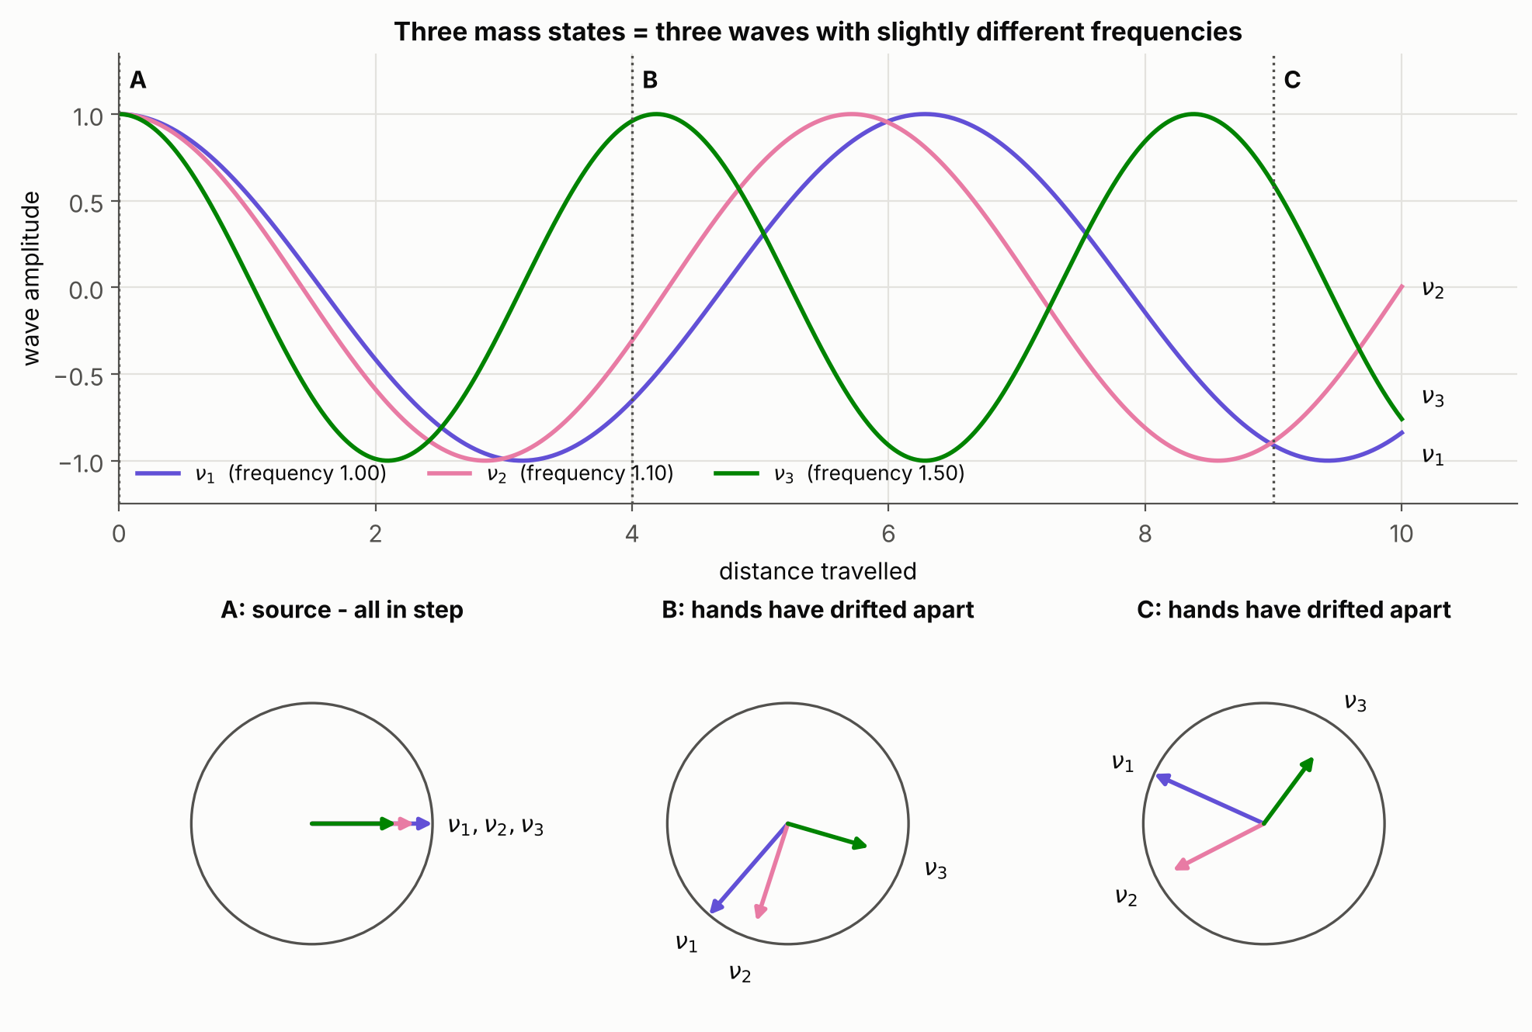
Three clocks that drift apart
ANALOGY 1
At the source
All three clocks start together. That exact pattern is a pure ν_{e}.
On the way
Each clock ticks at its own rate, set by its mass, so the hands drift apart.
At the detector
The new pattern looks partly like ν_{μ} or ν_{τ}. Later it can line up again.
7
Notes:
Each mass state is like a wave or a clock hand rotating at a frequency set by its mass. The flavor is decided by the whole pattern of relative phases compared with the pattern at the source, not by a simple rule like "two in phase means muon". Remember that this is an analogy. Real neutrinos are quantum amplitudes, and what oscillates is a probability.

Slide 8
Electrons in atoms, neutrinos in flight
ANALOGY 2
 | Electron in an atom | Neutrino in flight
Stationary states | Energy levels: 1s, 2s, 2p… | Mass states: ν₁, ν₂ and ν₃
A measurement gives | One definite energy | One definite mass: m₁, m₂ or m₃
A mixed state | 1s plus 2p: the charge cloud oscillates back and forth | A flavor neutrino: its flavor changes back and forth
The pieces of a mixed state pick up different phases, so the mixture changes in time.
8
Notes:
This analogy works because of the mixed state, not because of the levels. A free neutrino is not trapped like an electron in an atom, and it does not jump between mass states. The mass states are simply the states with a definite mass. A neutrino made in a weak interaction is not in any one of them. It is a superposition of all three, like an electron prepared in a mix of two orbitals, and the two pieces evolve with different phases.

Slide 9
Deriving the two-flavor formula
TWO FLAVORS
ν_{e} = cos θ ν₁ + sin θ ν₂
1 · Mix
ν_{μ} = −sin θ ν₁ + cos θ ν₂
2 · Evolve
$$v\left(t\right)= cos{θe^{\left\{−iE_{1}t\right\}}v_{1}}+\sin{θe_{2}^{\left\{−iE_{2}t\right\}}v_{2}}$$
3 · Amplitude
A = $\left.\left\langle v_{μ} | v\left(t\right)\right.\right\rangle =sinθcosθ\left(−e^{−iE_{1}t}−e_{2}^{−iE_{2}t}\right)$
P = |A|² = 4 sin²θ cos²θ · sin²[(E2 − E1)t / 2]
4 · Probability
= sin²2θ · sin²[(E2 − E1)t / 2]
E2 − E1 ≈ Δm² / 2E and t ≈ L
5 · Use L and E
P(ν_{e} → ν_{μ}) = sin²2θ · sin²(Δm² L / 4E)
9
Notes:
Units are hbar = c = 1, two flavors, vacuum. Step 1: the flavor states are rotations of the mass states by the mixing angle. Step 2: a mass state has a definite energy, so it only picks up a phase, exp of minus i E t. Step 3: project onto the muon flavor, using the bra of the muon state, which is minus sin theta times the bra of nu-1 plus cos theta times the bra of nu-2. Step 4: the squared magnitude of the difference of two phases is 4 sin squared of half the phase difference, and 4 sin squared theta cos squared theta equals sin squared of 2 theta. Step 5: for a light neutrino the energy is about p plus m squared over 2E, so the energy difference is delta m squared over 2E, and the neutrino travels at nearly the speed of light, so t is about L. That gives the standard result, which in practical units has 1.27 times delta m squared L over E inside the second sine. The probability to stay an electron neutrino is one minus this.

Slide 10
One formula captures it
TWO FLAVORS
P(ν_{e} → ν_{μ}) = sin²2θ · sin²(Δm² L / 4E)
sin²2θ
Δm² L / 4E
Both needed
The height
The pace
Or nothing happens
The mixing angle θ sets how much the flavor can change. It is largest at 45°.
The mass difference, the distance L and the energy E set how fast it changes.
With no mixing or no mass difference, a neutrino keeps its flavor.
10
Notes:
This is the probability to detect a muon neutrino after a neutrino born as an electron neutrino has travelled a distance L with energy E, for two flavors in vacuum. The first factor is the amplitude and depends only on the mixing. The second factor is the phase, and it depends on the mass-squared difference and on L over E. Units: with Δm² in eV squared, L in kilometers and E in GeV, the argument of the second sine is 1.27 times Δm² L / E.

Slide 11
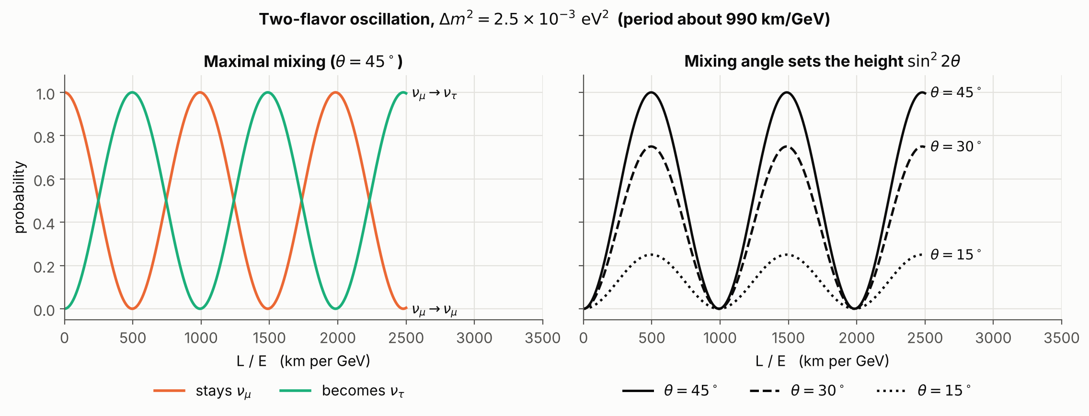
What an oscillation looks like
TWO FLAVORS IN PRACTICE
11
Notes:
The curves repeat with a period set by the mass difference. For a mass-squared difference of 2.5 times 10 to the minus 3 eV squared, one full oscillation takes about 990 km per GeV. On the left, a muon neutrino turns completely into a tau neutrino and back. On the right, only the height changes when the mixing angle changes, not the pace. The probabilities always add up to one: the neutrino is not lost, it is only changing identity.

Slide 12
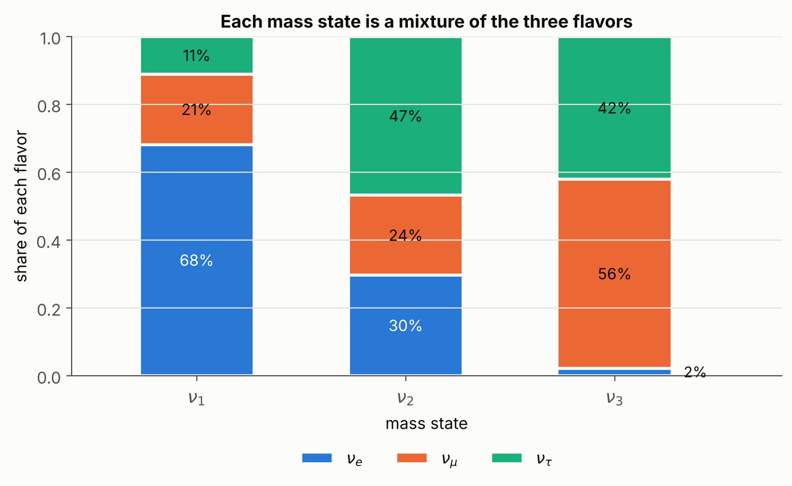
Three angles and one phase
THREE FLAVORS
Parameter | About | Measured with
θ12 | 33° | solar neutrinos
θ23 | 49° | atmospheric
θ13 | 8.6° | reactors
Δm²21 | 7.4×10⁻⁵ eV² | solar neutrinos
Δm²31 | 2.5×10⁻³ eV² | atmospheric
δ (CP) | not yet known | accelerators
Approximate global-fit values.
What each mass state is made of
12
Notes:
With three flavors the mixing matrix is 3 by 3. It is built from three rotations, one measured by solar neutrinos, one by atmospheric neutrinos and one by reactor neutrinos, plus a CP-violating phase delta that is not yet well measured. There are also two independent mass splittings. The bars show how much of each flavor sits inside each mass state: nu-1 is mostly electron-like, nu-2 is a nearly even mixture, and nu-3 is mostly a mixture of muon and tau with very little electron. The values are approximate global-fit numbers and the ordering of the masses is still unknown.

Slide 13




What oscillation tells us
WHY IT MATTERS
Beyond the Standard Model
An unfinished mass puzzle
Oscillation proves that neutrinos have mass, which the original Standard Model left out.
Oscillations give only mass differences. The absolute mass scale and the mass ordering are still unknown.
Matter and antimatter
The next experiments
If neutrinos and antineutrinos oscillate differently, it could help explain why the universe contains matter.
JUNO, DUNE and Hyper-Kamiokande aim to settle the mass ordering and the CP phase.
13
Notes:
Four takeaways. First, oscillation is direct evidence of physics beyond the original Standard Model. Second, we know the mass differences but not the absolute masses, and we do not yet know whether neutrinos are their own antiparticles. Third, a difference between neutrino and antineutrino oscillations, called CP violation, could be part of the story of why the universe is made of matter. Fourth, new experiments such as JUNO, DUNE and Hyper-Kamiokande are built to answer these questions.

Slide 14

Neutrinos on a quantum computer
CONNECTION TO QUANTUM COMPUTING
ν_{e}
U†
φ
U
P
Prepare
Change basis
Add phases
Change back
Measure
Start in a flavor state.
Rotate to the mass basis.
Each mass state gets its own phase.
Rotate to the flavor basis.
Counts give the flavor probabilities.
1 qubit
2 qubits
A check
Two flavors. The state is a point on the Bloch sphere.
Three flavors, using the basis states 00, 01 and 10.
The measured counts should match the exact curves.
14
Notes:
Oscillation is a unitary evolution of a small quantum state, so it maps naturally onto qubits. The recipe is the same as the theory: write the flavor state in the mass basis, give each mass state its phase, and rotate back to the flavor basis. Two flavors need one qubit, and in the Bloch sphere picture the state precesses around the mass axis like a spin in a magnetic field. Three flavors need two qubits, using three of the four basis states. Running the circuit for many distances and measuring counts should reproduce the exact curves, which gives a built-in check of the simulation.

Slide 15
Five things to remember
SUMMARY
1
Neutrinos come in three flavors: ν_{e}, ν_{μ} and ν_{τ}.
2
They travel as three mass states, ν₁, ν₂ and ν₃, with slightly different masses.
3
Each flavor is a different mixture of the mass states, set by the PMNS matrix.
4
The mass states drift out of phase, so the flavor oscillates with distance over energy.
5
Oscillation proves that neutrinos have mass, which points beyond the Standard Model.
15
Notes:
Recap in one breath: flavor is what we see at birth and at detection, mass is what travels, flavor is a mixture of mass states, the mass states drift out of phase, and that drift is oscillation. Because it needs different masses, oscillation is the first laboratory evidence of physics beyond the original Standard Model.

Slide 16
Thank you
Questions?
Notes:
Close by returning to the three waves from the opening: they start in step, drift apart, and that drift is the oscillation. Invite questions. For further reading: the Particle Data Group review on neutrino masses, mixing and oscillations, the NuFIT global fits for up-to-date parameter values, and the Nobel Prize 2015 scientific background.

